Slide 1
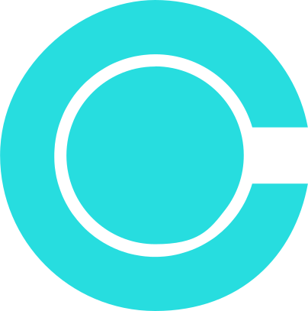
nexora
Visualytix – Visual Difference Engine
Spot the invisible. Prevent the inevitable.
Team members :
Naveen kumar, Srinath, Yuvarrunjitha

Slide 2


nexora
PROBLEM STATEMENT
Visual Difference Engine
Industries like manufacturing, infrastructure, and brand compliance, visual inspection systems struggle with reliability.
Existing AI models either miss real defects such as cracks or corrosion, or generate false alarms by flagging harmless lighting or shadow variations.
This leads to alert fatigue, production delays, and loss of trust in automation — making accurate, explainable, and adaptable visual inspection a critical unmet need.

Slide 3
nexora
our solution :
VisuaLytix is an AI-powered inspection engine that doesn’t just find change — it understands it.
What it does
Outcome:
Given a baseline (reference) image and a new (inspection) image, VisuaLytix:
Detects real defects — cracks, rust, logo mismatches, etc.
Ignores false alarms — lighting flicker, reflections, and shadows.
Classifies changes — identifies type and severity of defects.
Explains decisions — provides Grad-CAM heatmaps showing why it flagged an issue.
A trustworthy visual inspection system that gives an actionable report like:
“Critical Crack Detected — Severity 9/10”

Slide 4
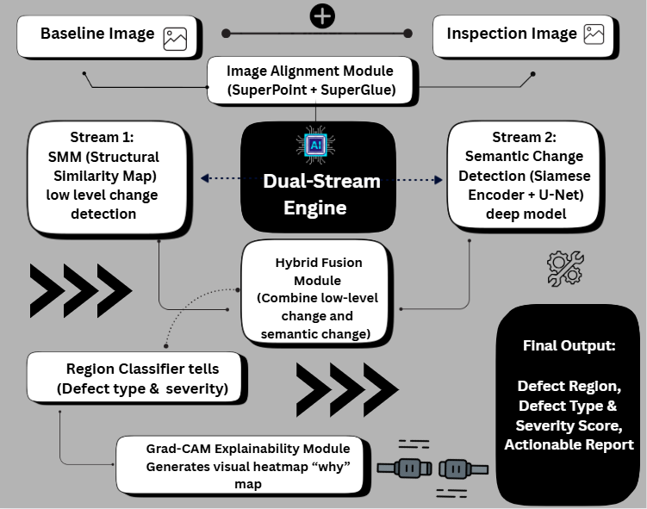
WORK FLOW AND
MODEL PIPELINE

Slide 5

UNIQUENESS AND NOVELTY
nexora
What Makes VisuaLytix Different:
2. Explainable AI for Inspection
Most AI inspection systems are black boxes.
VisuaLytix uses Grad-CAM visualization to show why it flagged a defect — boosting operator trust and transparency.
1. Dual-Stream Confidence Engine (Our Core Innovation)
Unlike existing inspection AIs that rely only on
deep learning, we fuse two intelligence streams:
Semantic Stream (Siamese U-Net) — understands context (e.g., a shadow ≠ defect).
Structural Stream (SSIM Map) — detects physical pixel-level differences.
A change is flagged only when both agree — ensuring near-zero false alarms.
3. Synthetic Data Generation Pipeline
We don’t depend on big datasets — we create our own.
Thousands of perfectly labeled training images are programmatically generated, allowing rapid adaptability to any new industry (automotive, packaging, or infrastructure).
4. Cross-Domain Flexibility
From manufacturing cracks to brand logo compliance, our architecture is domain-agnostic, making it deployable across industries without retraining from scratch.

Slide 6
nexora
Thank You

